Slide 1
SAMSUNG Innovation Campus
Stroke Prediction
Final ML Project
Presented by:
Mohamed Ibrahim & Noura Medhat
Supervised by : Dr.Doaa Mahmoud
Facilitator: Eng. Mariam

Slide 2

AGENDA
Introduction
Dataset Description
Exploratory data analysis
Dataset Preprocessing
Modeling
Conclusion
Business Solution
2

Slide 3
Introduction
3

Slide 4
A stroke is a serious life-threatening medical condition that happens when the blood supply to part of the brain is cutoff. Strokes are a medical emergency and urgent treatment is essential.
The sooner a person receives treatment for a stroke, the less damage is likely to happen.
The main symptoms of stroke can be remembered with the word FAST:
Face – the face may have dropped on 1 side, the person may not be able to smile.
Arms – the person with suspected stroke may not be able to lift both arms.
Speech – their speech may be slurred or garbled, or the person may not be able to talk at all.
4

Slide 5
Dataset Description
5

Slide 6

Dataset Description
1) id: unique identifier
2) gender: "Male", "Female" or "Other"
3) age: age of the patient
4) hypertension: 0 if the patient doesn't have hypertension, 1 if the patient has hypertension
5) heart_disease: 0 if the patient doesn't have any heart diseases, 1 if the patient has a heart disease
6) ever_married: "No" or "Yes"
7) work_type: "children", "Govt_jov", "Never_worked", "Private" or "Self-employed"
8) Residence_type: "Rural" or "Urban"
9) avg_glucose_level: average glucose level in blood
10) bmi: body mass index
11) smoking_status: "formerly smoked", "never smoked", "smokes" or "Unknown"
12) stroke: 1 if the patient had a stroke or 0 if not
6

Slide 7
EDA
7

Slide 8
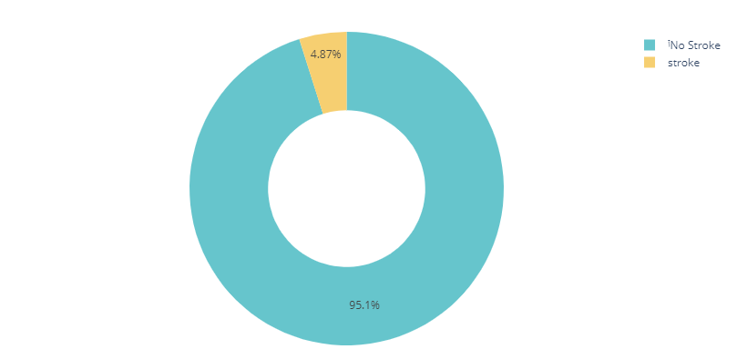
What percentage of people having Strokes?
Only 5% of data set are having stroke
8

Slide 9
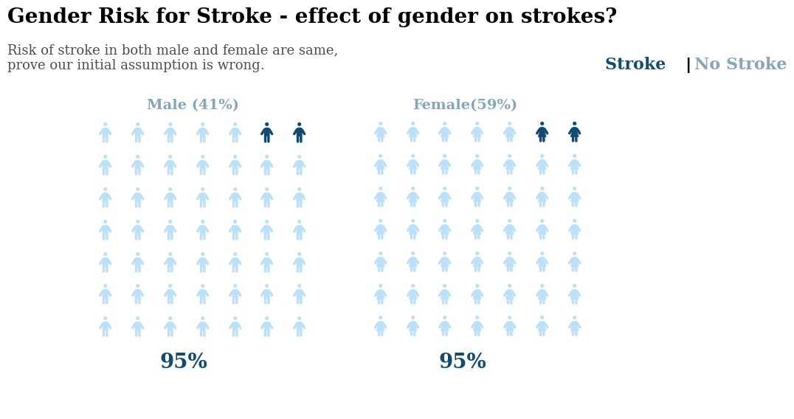
Which gender is more likely to get strokes?
From the previous illustration, risk of stroke on both males and females is the same which proves that our initial assumption is wrong.
9

Slide 10
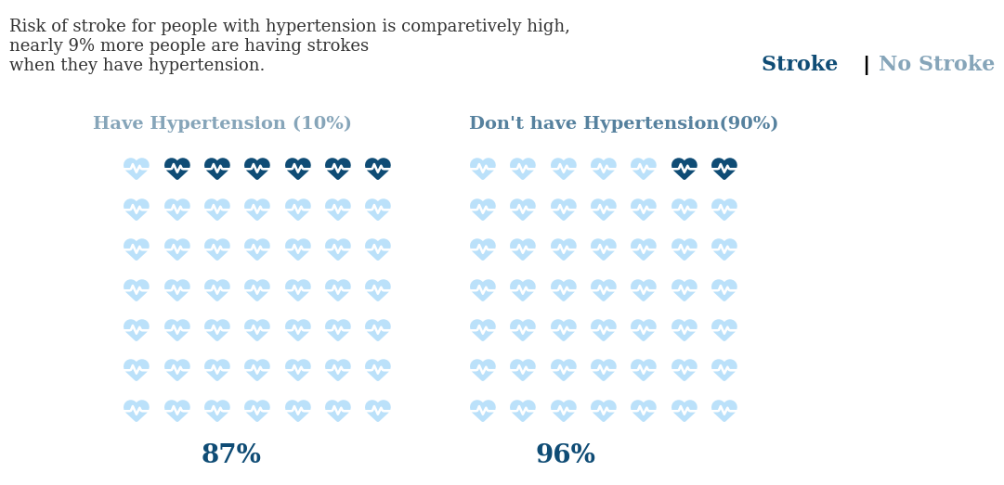
Does the hypertension have any effect on our target?
Risk of stroke on the people with hypertension is high, nearly 9% more people are having strokes when they have hypertension
10

Slide 11
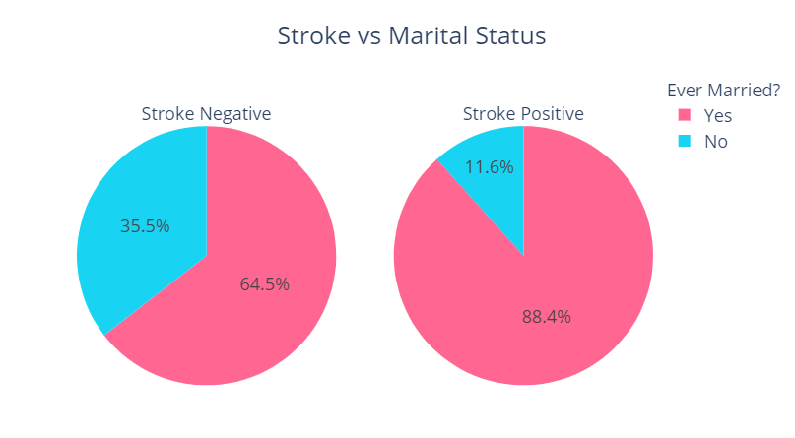
Marriage and stroke- effects of marriage on stroke?
Risk of stroke on married people is high .. Perhaps married people have more responsibilities and are subjected to more pressure and that is life.
11

Slide 12
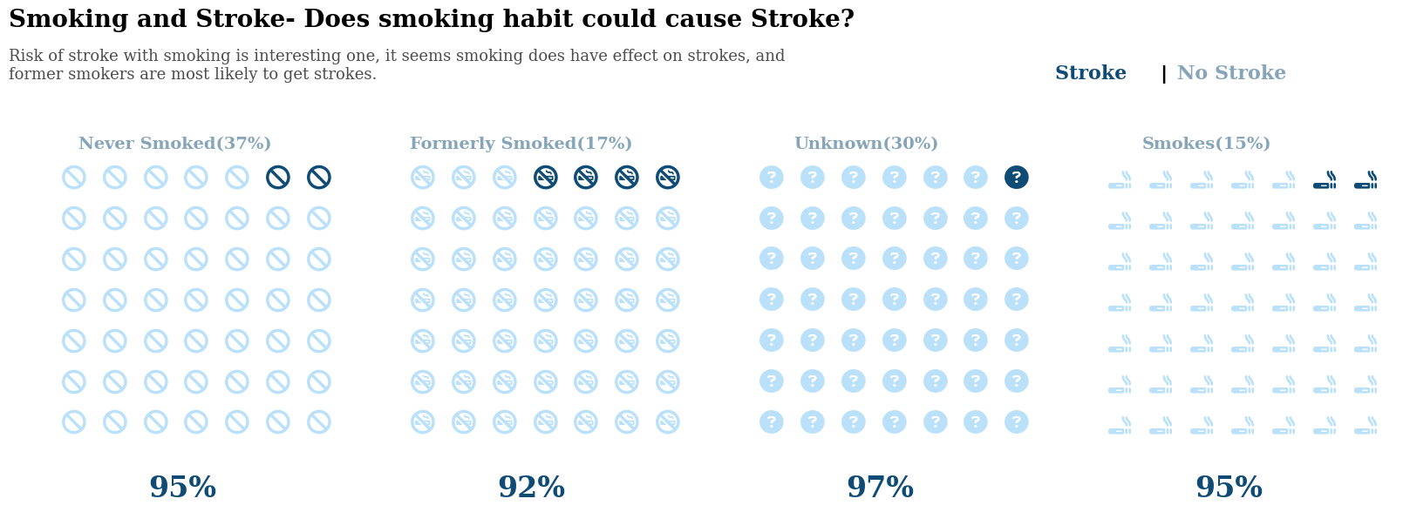
What is the relationship between a person's being smoker and getting a stroke?
Risk of stroke on people who smoke is interesting one, it seems smoking does have a significant effect on our target, and former smokers are most likely to get strokes
12

Slide 13
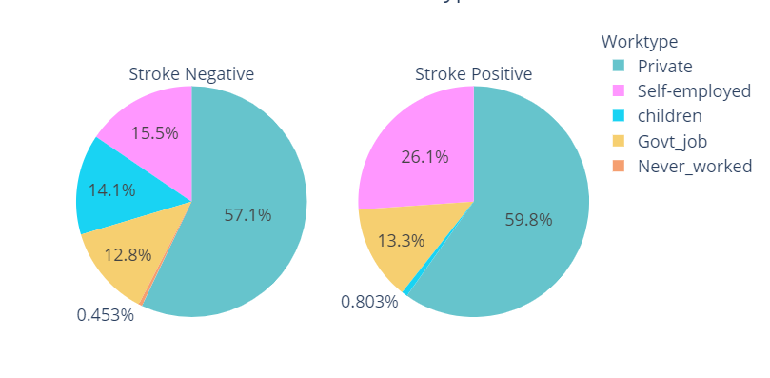
Does work pressure can cause Stroke ?
From the previous charts we can conclude that people who are self-employed are most likely to have strokes than the others. On the other hand most of strokes can be seen in the people who work privately.
13

Slide 14
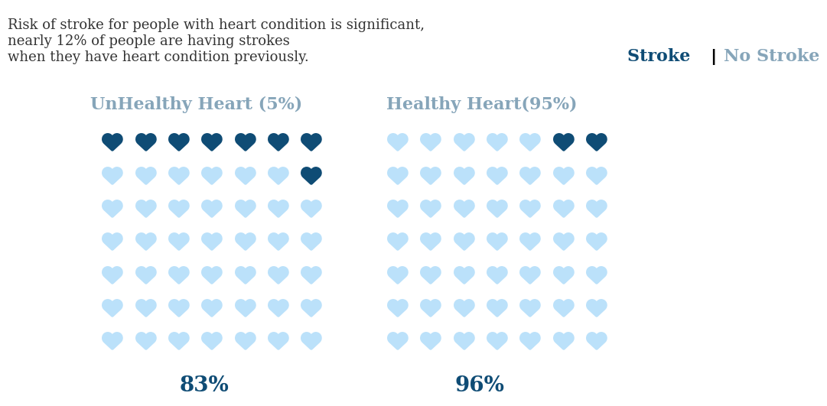
Is there any relationship between heart diseases and our target?
Risk of stroke on people with heart condition is significant, nearly 12% of people are having strokes when they have heart condition previously.
14

Slide 15
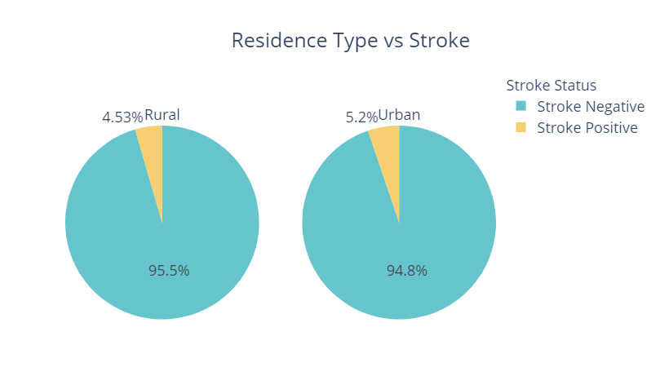
Is there any relationship between the environment and our target?
Location of home does not have that significant effect on our target. Both rural and urban people have similar possibilities of strokes.
15

Slide 16
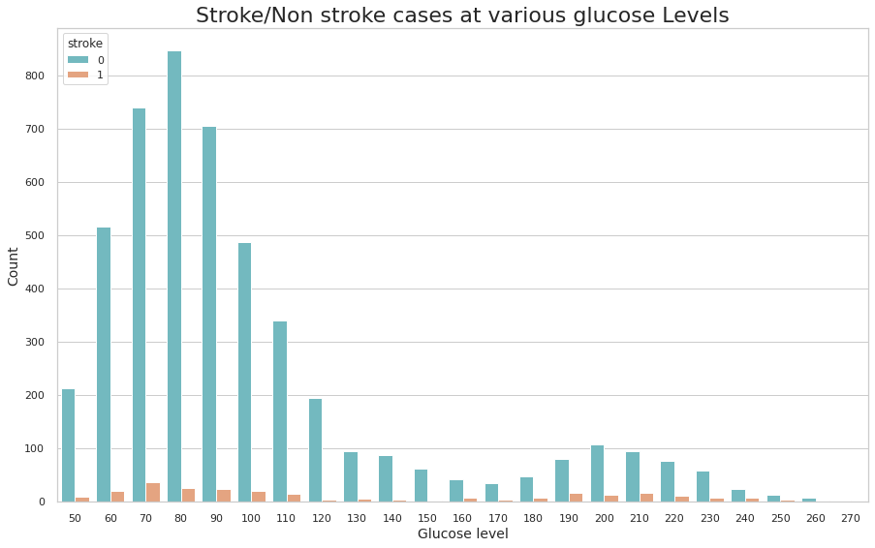
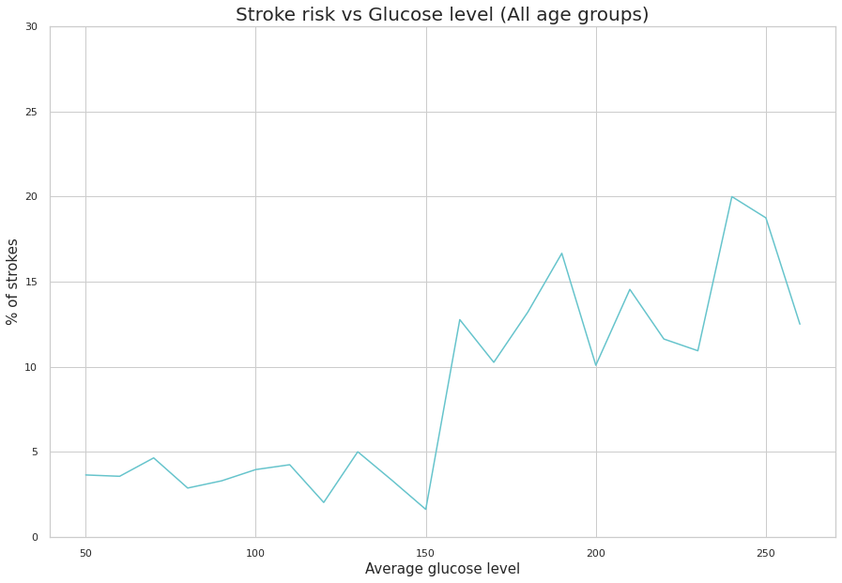
What is the relationship between the glucose level and the target?
From two previous plots :
We notice that the normal range of glucose in the blood ranges between 120-150, increasing or decreasing may cause disease.
Increasing the level of glucose in the blood affects the incidence of stroke where an increase of more than 150 increases the incidence rate from 5% to 10%
16

Slide 17
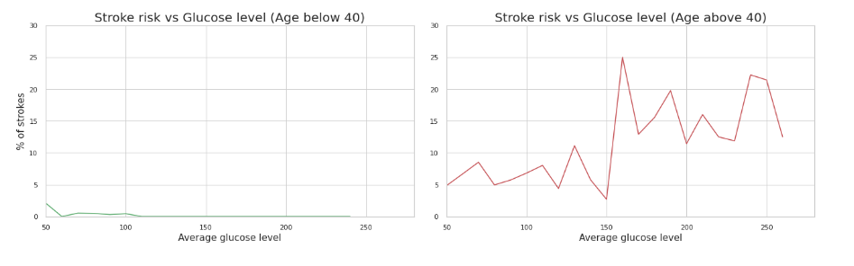
Relation between Stroke, Glucose level and age
1. people below 40 :
Increasing their glucose level does not affect their stroke, but a decrease in glucose level increases their rate of stroke.
2. people above 40 :
Increasing their glucose level has a significant impact on their stroke, where the increase above normal (150) increases the percentage of their disease from 5 -10 % to 10- 25 %
14

Slide 18
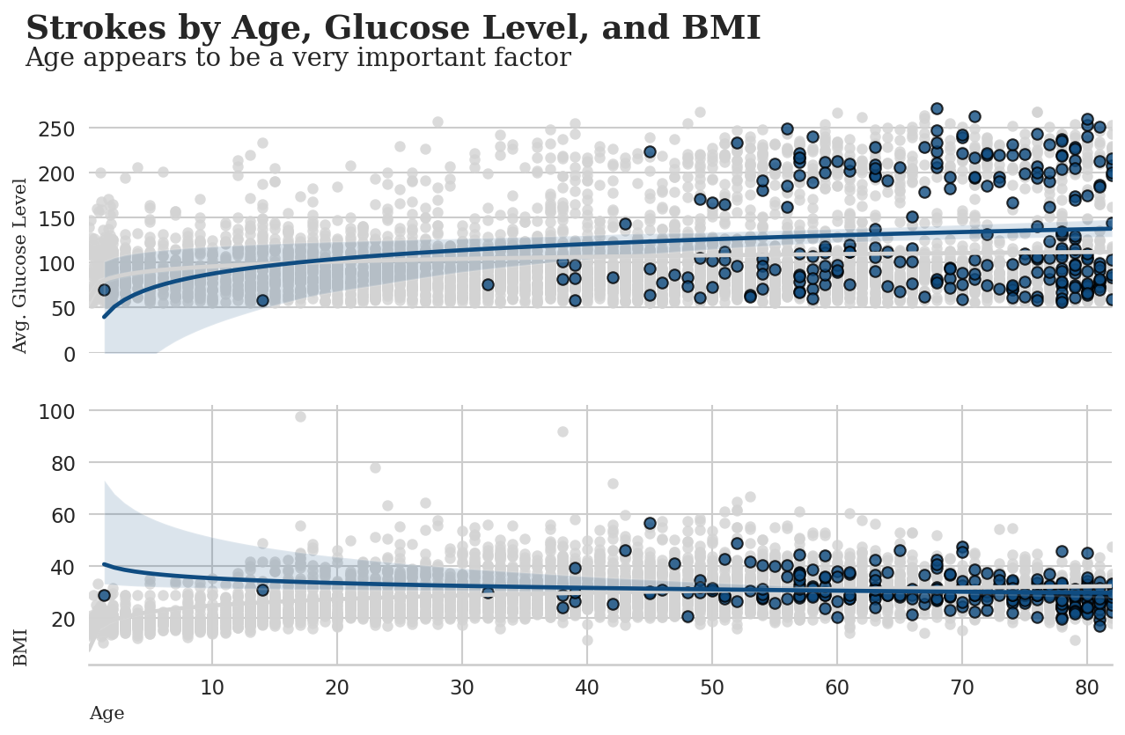
Stroke by Age , Glucose level and BMI
As expected, age is a very important factor, and also has a relationships with BMI & Avg. Glucose levels.
As the age increases, the risk of having a stroke increases too.
18

Slide 19
Dataset Preprocessing
19

Slide 20
Preprocessing
Handling the missing values
Encoding.
Features Selection
01
02
03
04
05
06
Handling the outliers.
Scaling
Imbalanced data
20

Slide 21
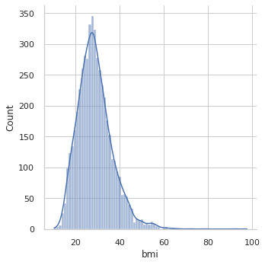
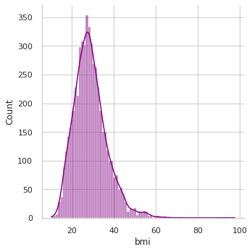
Handling the missing values
There are only 201 missing values in the bmi column
Column’s distribution after filling the missing values randomly
Column’s distribution before handling the missing values
21

Slide 22
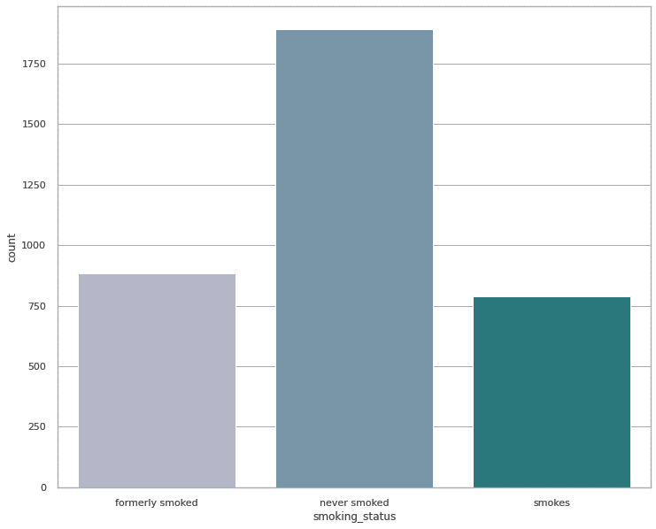
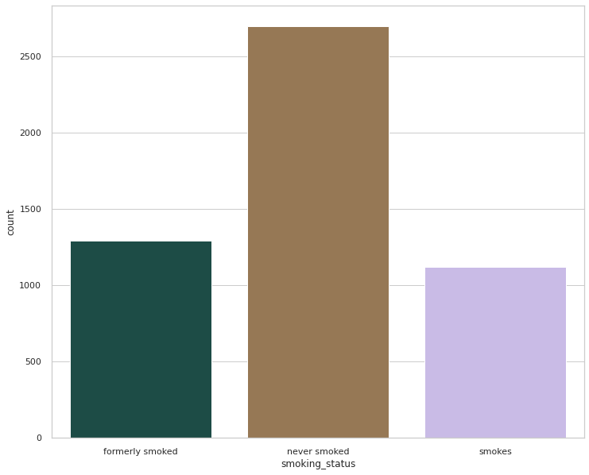
Handling the missing values
There are only 1544 missing values in the smoking_status column
Column’s distribution before handling the missing values
Column’s distribution after filling the missing values randomly
Now, there is no missing values
22

Slide 23
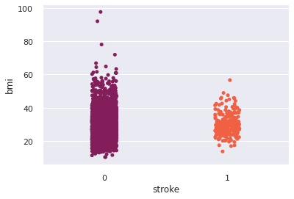
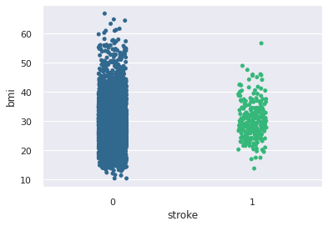
Handling the outliers
There are outliers in the bmi column
Scatter plot for the column before handling the outliers
Scatter plot for the column after handling the outliers
Gender Column has 3 categories: males, females and others. The “others” category has one record which can be considered outlier, so we dropped it.
23

Slide 24
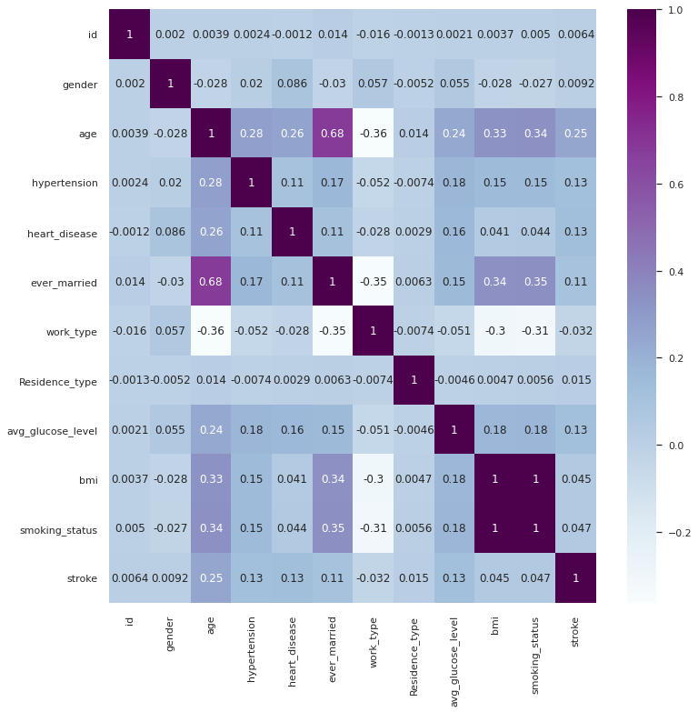
Features Selection
From the correlation table, we can just keep the features which are correlated to target. We are going to keep age, hypertension, heart_disease, avg_glucose_level, bmi and ever_married.
24

Slide 25
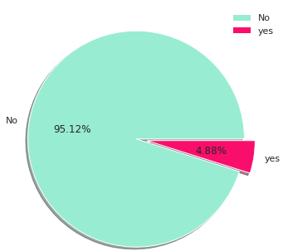
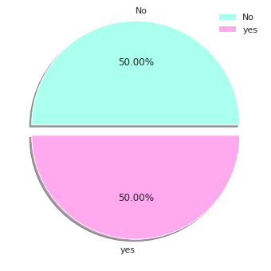
Imbalanced Data
Target class distribution before solving the problem
Target class distribution after solving the problem.
Random Over-Sampling
Oversampling can be defined as adding more copies to the minority class. Oversampling can be a good choice when you don’t have a ton of data to work with.
25

Slide 26
Modeling
26

Slide 27
Stroke
Prediction
The dataset is a classification dataset and the target, which is stroke, has 2 classes:
Yes (encoded to be represented with 1)
No (encoded to be represented with 0)
27

Slide 28
ML Models
K-Nearest Neighbor
Decision Tree
Non-parametric model, depends on the idea of the entropy and the information gain
Non-parametric model, uses a distance metric in order to classify
K-Nearest Neighbor
Decision Tree
Support Vector Machine
It is the modification of the logistic regression model.
Logistic Regression
Binary classifier and it is the transformation of the linear regression.
Support Vector Machine
Logistic Regression
28

Slide 29
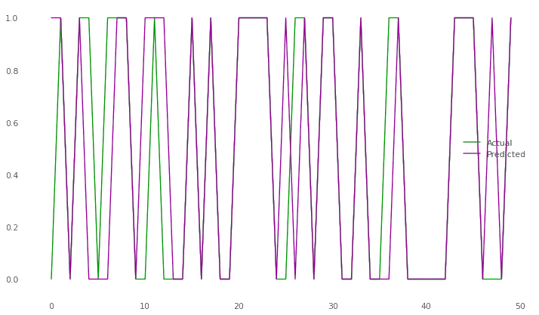
Logistic Regression
79.6%
Model Training score
79.1%
Model Testing Score
29

Slide 30
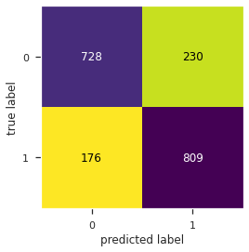
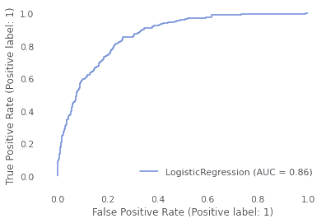
LR Evaluation
1
F1 Score
3
Precision
0.799
0.799
0.778
0.79
0.821
2
ROC AUC Score
4
Recall
30

Slide 31
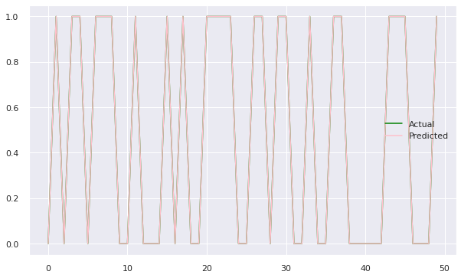
K-Nearest Neighbor
100%
Model Training score
97.6%
Model Testing Score
By setting the hyperparameter n-neighbors to be 2. (Using Grid Search technique)
31

Slide 32
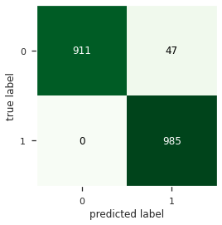
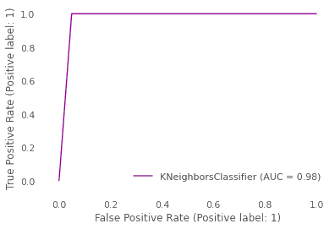
KNN Evaluation
1
F1 Score
3
Precision
0.799
0.976
0.954
0.975
1.0
2
ROC AUC Score
4
Recall
32

Slide 33
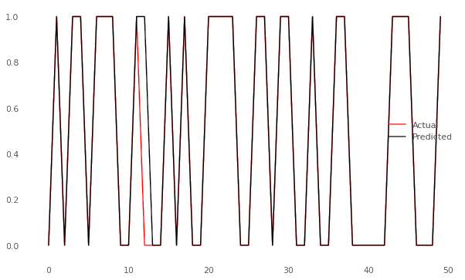
Decision Tree
99.7%
Model Training score
97.1%
Model Testing Score
By setting the hyperparameter max_depth to be 21 and max_features to be 3. (Using GridSearch technique)
33

Slide 34
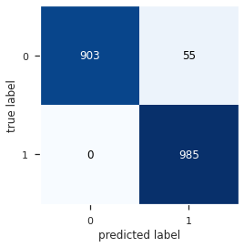
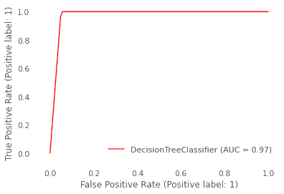
DT Evaluation
1
F1 Score
3
Precision
0.799
0.972
0.974
0.971
1.0
2
ROC AUC Score
4
Recall
34

Slide 35
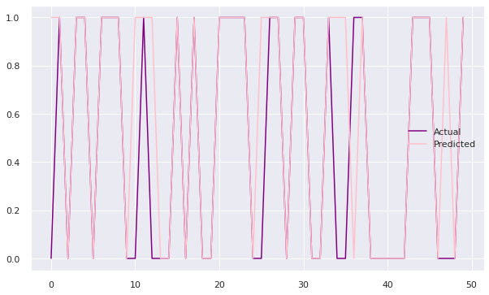
Support Vector Machine
80.8%
Model Training score
80.5%
Model Testing Score
35

Slide 36
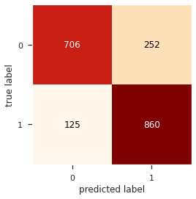
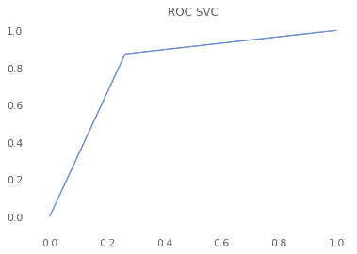
SVM Evaluation
1
F1 Score
3
Precision
0.799
0.82
0.77
0.805
0.87
2
ROC AUC Score
4
Recall
36

Slide 37
Ensemble ML Models
AdaBoost
Has the same parameters of the RF. Based of the idea of Boosting
XGBoost
It’s an update of GBM. Mainly based on DT.
XGBoost
AdaBoost
Random Forest
Voting
Ensemble ML model based on the Bootstrapping concept
Combine different models together.
Random Forest
Voting
37

Slide 38
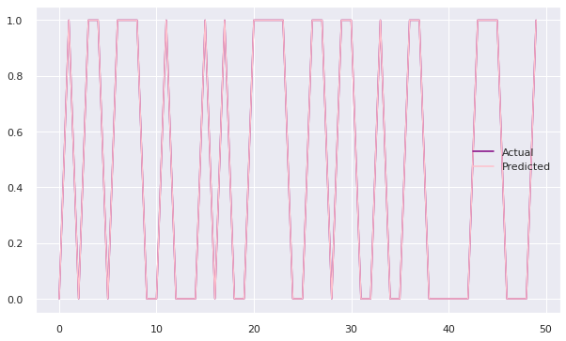
Random Forest
99.6%
Model Training score
97.3%
Model Testing Score
38

Slide 39
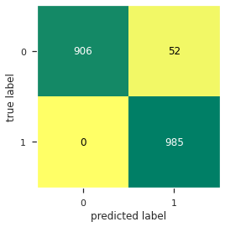
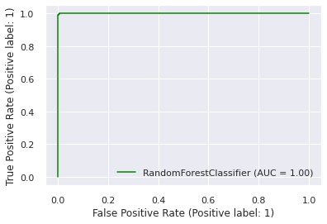
RF Evaluation
F1 Score
Precision
0.974
0.949
ROC AUC Score
Recall
0.972
1.0
39

Slide 40
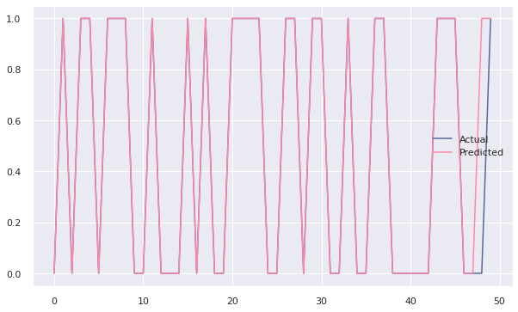
XGBoost
100%
Model Training score
97.8%
Model Testing Score
40

Slide 41
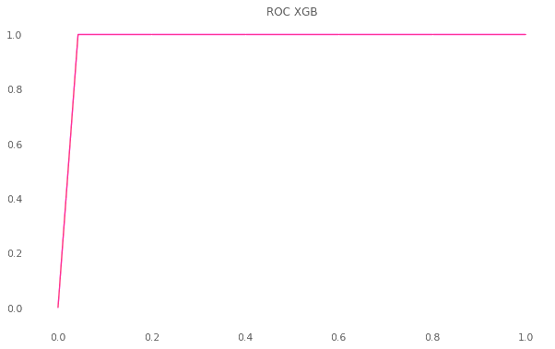
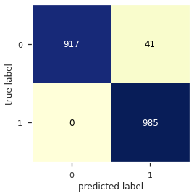
XGBoost Evaluation
F1 Score
Precision
0.979
0.96
ROC AUC Score
Recall
0.978
1.0
41

Slide 42
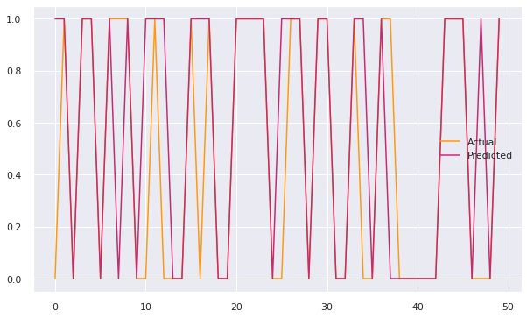
AdaBoost
80.6%
Model Training score
79.8%
Model Testing Score
42

Slide 43
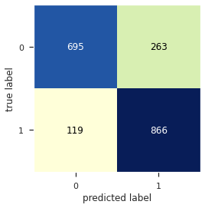
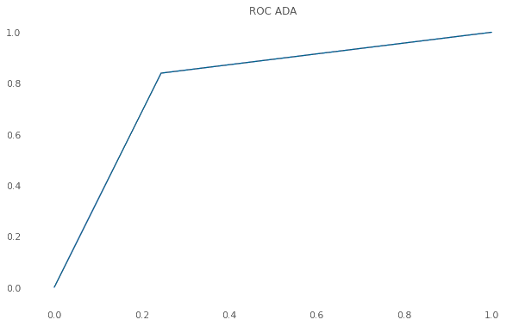
AdaBoost Evaluation
F1 Score
Precision
0.808
0.779
ROC AUC Score
Recall
0.797
0.839
43

Slide 44
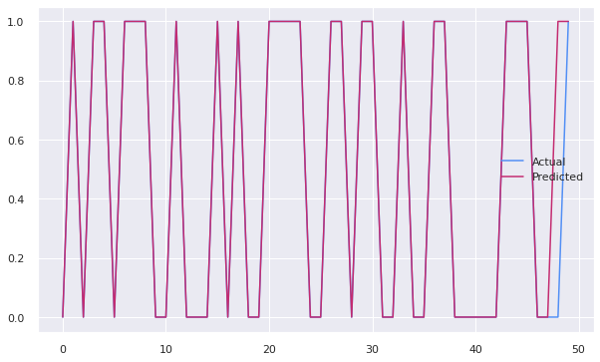
Voting
100%
Model Training score
97.8%
Model Testing Score
44

Slide 45

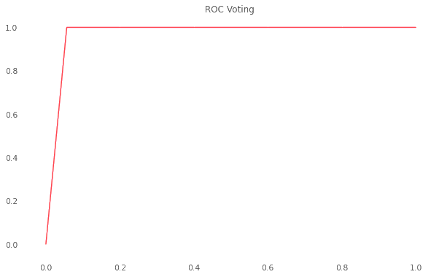
Voting Evaluation
F1 Score
Precision
0.973
0.948
ROC AUC Score
Recall
0.972
1.0
45

Slide 46
Business Solution
47

Slide 47
Solution
For low budget: We aim at developing a desktop application to be used in hospitals in order to save more lives.
This desktop application will predict whether the patient could have a stroke based on their history.
For high budget: We can develop an expert system which has 3 main components
Knowledge base: It contains domain, specific and high quality knowledge
Interface engine: It acquires and manipulates the knowledge from the knowledge base to arrive at a particular solution
User interface: It provides a user-friendly interaction between the expert system and the system itself
48

Slide 48
Conclusion
47

Slide 49
Conclusion
XGBoost is the best model to deployed
Based on the previous scores XGBoost is the best model here. In this algorithm, decision trees are created in sequential form. Weights play an important role in XGBoost. Weights are assigned to all the independent variables which are then fed into the decision tree which predicts results. The weight of variables predicted wrong by the tree is increased and these variables are then fed to the second decision tree. These individual classifiers/predictors then ensemble to give a strong and more precise model.
46

Slide 50






Thanks!
Please, feel free to contact us for any further information.
49

